Slide 1
FHIR for Executives & Managers
Lloyd McKenzie
Oct. 10, 2017

Slide 2
This presentation
Is licensed for use under the Creative Commons, specifically:
Creative Commons Attribution 3.0 Unported License
(Do with it as you wish, so long as you give credit)
Can be downloaded here:
https://github.com/FHIR/documents/blob/master/presentations/2017-10%20Payors/FHIR%20for%20Executives.pptx

Slide 3

Who am I?
Name: Lloyd McKenzie
Company: Gevity
Background:
One of FHIR’s 3 initial editors
Co-chair FMG & FHIR Infrastructure
Co-chair HL7 Modeling & Methodology
Heavily involved in HL7 and healthcare exchange for last 17 years (v2, v3, CDA, etc.)
lmckenzie@gevityinc.com

Slide 4
Tutorial Objectives
You should:
Know where FHIR fits in the broader healthcare landscape, including other HL7 specifications
Be able to explain what FHIR is to others in your organization
Be able to evaluate whether and how FHIR is relevant to your organization and within what timelines
Have a basic picture of what’s happening in the FHIR implementation space right now

Slide 5
Outline
Before break
After break
Why FHIR?
What makes FHIR different?
Core principles
Power of an interface
FHIR Resources
How does FHIR Compare?
FHIR Status
Where is FHIR being used?
Risks & Next steps
Notes:
Toggle

Slide 6
Outline
Monday
Tuesday
Why FHIR?
What makes FHIR different?
Core principles
Power of an interface
FHIR Resources
How does FHIR Compare?
FHIR Status
Where is FHIR being used?
Risks & Next steps
Notes:
Toggle

Slide 7
Attendees
Who is your organization?
What is your role?
HL7 (v2/v3/CDA) background?
How did you hear about FHIR?
How familiar are you with FHIR?
What is the one thing that will make this training most valuable for you?
Notes:
Toggle

Slide 8
WHY FHIR?

Slide 9

http://xkcd.com/927

Slide 10
Existing healthcare standards and bodies
HL7 – v2, v3, CDA
OpenEHR
CDISC – SDTM, ADAM, define.xml
X12
CTS
ISO – 11179, 21090, etc.
DICOM
W3C – Xforms, XSD
Many others
Do we really need one more?

Slide 11
The Need
Has been a need to share healthcare information electronically for a long time
HL7 v2 is over 30 years old
Increasing pressure to broaden scope of sharing
Across organizations, disciplines, even borders
Mobile & cloud-based applications
Faster – integration in days or weeks, not months or years

Slide 12
What we have – v2
Works relatively well within institutions
But
Legacy, custom syntax (learning curve, tools)
Messaging design limits architectures
Doesn’t scale well across organization boundaries
Security/privacy infrastructure is minimal
A potpourri of segments and fields with no means to distinguish the common from edge case

Slide 13
What we have – v3
Newer technology and semi-robust reference model, but
Steep learning curve
Primary implementations by those with $$$$s
No inter-version wire compatibility
International specifications are too abstract, regional implementations don’t interoperate

Slide 14
What we have - CDA
Broad implementation, human-to-human interoperability, but:
Still a very steep learning curve
Interoperability beyond a human-to-human level is still a challenge, even with templates
Document architecture doesn’t fit all problems
Still a diversity of implementations
Extensibility is difficult

Slide 15
Where we’ve gotten
v2, v3 and CDA have produced “bigger” silos
Different IGs / implementations create barriers
Interoperating still requires painful mapping & transformation exercises.
Low discoverability – lots of technical discussions needed before data can flow
Silos are inevitable – differing requirements
But need to lower the barriers and reduce time to build connections between them

Slide 16
So I should drop everything and use FHIR?
Tossing functioning systems the instant a promising newcomer appears is not generally a wise strategy
There’s room for something better
FHIR tries to fill that gap
Market will decide whether FHIR survives, coexists or replaces other products
Effort spent on v2, v3 & CDA can be still be leveraged
Notes:
There are flaws in what exists
There are new use-cases not being met

Slide 17
Problems we face
No central authorities
Permutation of biological and sociological complexity
Fractal use cases
Economics favors balkanization
Externalizing complexity
Much confusion about the problem

Slide 18
Complexity Model
Snomed
HL7 V3
openEHR
WS
CDA
Difficulty (log)
XML
HL7 v2
How?
HTTP / HTML
Text
Semantic Depth

Slide 19
Three Laws of Interoperability
Interoperability: It’s all about the people
You can hide the complexity, or make it worse, but you can’t make it go away
Cheap, flexible, and interoperable: pick two

Slide 20
Platform for Interoperability
Build capability for all systems
Only fix behavior
When everyone agrees to it
When it creates capability or simplicity
Push constraints on behavior to “Implementation Guides”
FHIR is loose, but capable
Implementation space will be fractal ☹

Slide 21
What is FHIR?
And how is it different?

Slide 22
The acronym
F – Fast (to design & to implement)
Relative – No technology can make integration as fast as we’d like
H – Healthcare
That’s why we’re here
I – Interoperable
Ditto
R – Resources
Building blocks – more on these to follow

Slide 23

Genesis of FHIR
What would healthcare exchange look like if we started from scratch using modern approaches?
Web search for success markers led to RESTful based APIs
Exemplar: Highrise (https://github.com/37signals/highrise-api)
Drafted a healthcare exchange API based on this approach

Slide 24
FHIR – Key differences
Focus on Implementers
Target support for common scenarios
Leverage cross-industry web technologies
Require human readability as base level of interoperability
Make content freely available
Support multiple paradigms & architectures
Demonstrate best practice governance
Notes:
We don’t actually have a formal manifesto, but these are the principles we adhere to.

Slide 25
Implementer Focus
Specification is written for one target audience: implementers (that’s not just programmers)
Rationale, modeling approaches, etc. kept elsewhere
Multiple reference implementations from day 1
Publicly available test servers
Starter APIs published with spec
C#, Java, Pascal, Swift, more coming
Connectathons to verify specification approaches
Instances you can read and understand ☺
Lots of examples (and they’re valid too)
using HL7.Fhir.Instance.Model;
using HL7.Fhir.Instance.Parsers;
using HL7.Fhir.Instance.Support;
XmlReader xr = XmlReader.Create(
new StreamRead
IFhirReader r = new XmlFhirReader
// JsonTextReader jr = new JsonTe
// new StreamRead
// IFhirReader r = new JsonFhirRe
ErrorList errors = new ErrorList(
LabReport rep = (LabReport)Resour
Assert.IsTrue(errors.Count() == 0
Notes:
Spec is driven by people who write code
Numerous pieces have been changed because of experience with what worked when trying to implement
Even have a test workbench for RESTful servers

Slide 26
Support “Common” Scenarios
80%
Inclusion of content in core specification is based on “80%” rule
Only include data elements we are confident that most (~80%) of normal implementations using that resource will make use of
Other content in extensions (more on this later)
Easy to say, governance challenge to achieve
Resources are simple and easy to understand & use
Notes:
Design by constraint failed – years to develop, what was produced required yet more design to be implementable and after that might not be interoperable
How to determine the 80%? Look to existing specs – v2, v3, CDA templates, OpenEHR, jurisdictional projects, what implementations we’ve seen
If not sure, err on the side of “not in for now”
Note: not 80% of instances, 80% of implementations
Challenges with “raising the bar”
What happens when there aren’t many/any implementations?

Slide 27
Example – ISO AD type
isNotOrdered, updateMode, flavorId, nullFlavor, controlAct root & extension, validTime low and high, useable period (GTS – no room on the slide), use
home, primary home, vacation home, workplace, direct, public, bad, physical, postal, temporary, alphabetic, ideographic, syllabic, search, soundex, phonetic
0..* parts, each with:
value, code, code system, code system name, code system version, language, type:
address line, additional locator, unit identifier, unit designator, delivery address line, delivery installation type, delivery installation area, delivery installation qualifier, delivery mode, delivery mode identifier, street address line, building number, building number numeric, building number suffix, street name, street name base, street type, direction, intersection, care of, census tract, country, county or parish, municipality, delimiter, post box, precinct, state or province, postal code, delivery point identifier
Notes:
How many of your systems have user interfaces that support even ¼ of this?

Slide 28
Example – FHIR Address
isNotOrdered, updateMode, flavorId, nullFlavor, controlAct root & extension, validTime low and high, useable period (low, high) (GTS – no room on the slide), use
home, primary home, vacation home, workplace, direct, public, bad, physicalvisit, postal, temporary, alphabetic, ideographic, syllabic, search, soundex, phonetic, old
0..* parts, each with:text
value, code, code system, code system name, code system version, language, type:
address line, additional locator, unit identifier, unit designator, delivery address line, delivery installation type, delivery installation area, delivery installation qualifier, delivery mode, delivery mode identifier, street address line, building number, building number numeric, building number suffix, street name, street name base, street type, direction, intersection, care of, census tract, country, county or parish, municipalitycity, delimiter, post box, precinct, state or province, postalCode, delivery point identifier
Notes:
This is what happens when you apply the 80% . . .

Slide 29
Won’t extensions break interoperability?
The 80% + narrative helps provide “base” interoperability
For “robust” interoperability
Profile – constrains structure
Conformance – constrains behavior
Needed to claim “I’m FHIR conformant”
Notes:
1000s of extensions, everyone supports different things, don’t know what anyone does
Not everyone will support the 80%, but most will
“What most systems support” (and thus what you should probably support too) encourages base interoperability
Human readable fallback
Profile – what elements are supported, registries available
Conformance – REST operations, documents, messages, services

Slide 30
Web technologies
Instances shared using XML & JSON
Web calls work the same way they do for Google & Twitter
Rely on HTTPS, OAuth, etc. for security functions
Benefits
Cross-Industry standards
Well supported by tools
Understood by developers
http://...
Notes:
We try very hard to *not* invent stuff that exists elsewhere unless it’s really broken or totally unaligned with the FHIR principles.

Slide 31

Human Readable
Clinical Documents has both narrative and data
The data / narrative dynamic exists throughout the process
In FHIR, every resource can (should) have a human-readable expression
Can be direct rendering or human entered
Notes:
Even when you think your target will understand all the encoded data, reality is data often gets shared beyond the originally intended context
Allow for exceptions for things like automated device readings, etc.

Slide 32
Freely available
Unencumbered – free for use, no membership required
http://hl7.org/fhir + other versions
Licensed under CC0: True public domain
Any use is allowed
HL7 enforces the trademark protection
Business model:
If you want to vote, you need to pay
Notes:
Was a bigger deal before HL7 decided to open up all IP
Link to full legal text towards bottom of FHIR home page

Slide 33
Paradigms
FHIR supports 4 interoperability paradigms
REST – Lightweight, leverages web stack
Documents – Long-term persistence
Messages – Request/response paradigm
Services – other SOA-based interfaces
Regardless of approach, content stays the same
Can leverage same models, same profiles everywhere

Slide 34
Review
What are FHIR’s 7 “Key Differences”

Slide 35

Architectures
FHIR makes no assumptions about the architectural design of systems
Notes:
Light or heavy clients
Central server or peer-to-peer sharing
Push or pull
Query or publish/subscribe
Loosely coupled or tightly coupled environments
With history tracking or without

Slide 36
FHIR & Cost of Integration
These factors will drive down the cost of integration and interoperability
Easier to Develop
Easier to Troubleshoot
Easier to Leverage in production
More people to do the work (less expensive consultants)
Competing approaches will have to match the cost, or disappear – effect is already being felt

Slide 37
Future impact of FHIR
Impact of FHIR on the market:
Drive interoperability prices down
Higher Expectations
Increased spend on integration (N x 2!)
Overall Market focus
PHR on the web
Healthcare repositories (MHD+)
Device Data management
Freeing data can enable new business models and new companies
Notes:
How much integration do you need? Nx2 – twice what you have

Slide 38
FHIR Resources

Slide 39
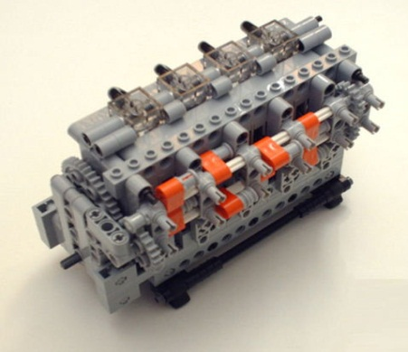
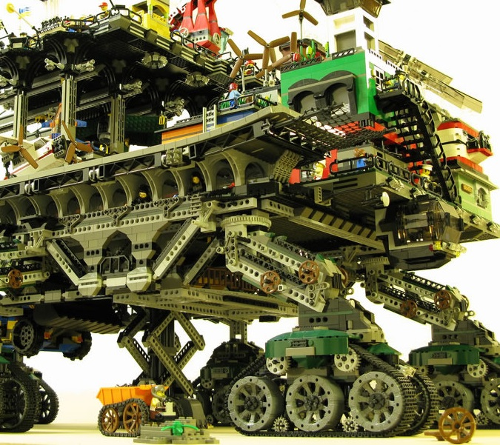

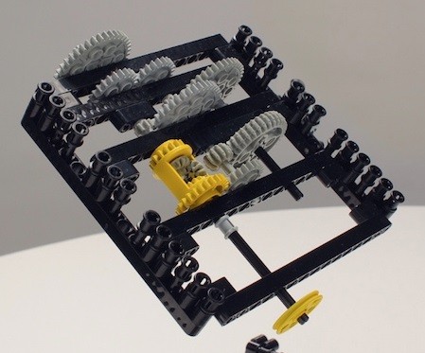
FHIR solutions
Resources
Extensions
Solution
+
=
Notes:
Resources are building blocks, but useful in their own right
Extensions supplement what resource doesn’t cover
Solutions can be simple or complex

Slide 40

Resources
“Resources” are:
Small logically discrete units of exchange
Defined behavior and meaning
Known identity / location
Smallest unit of transaction
“of interest” to healthcare
V2: Sort of like Segments
V3: Sort of like CMETs

Slide 41
FHIR Resource URLs
Template | Description | Example | Operations
[base] | Server URL | http://fhir.com | GET, POST
[base]/[type] | Collection Manager | http://fhir.com/Patient | GET, POST
[base]/[type]/[id] | URL for a resource | http://fhir.com/Patient /23 | GET, PUT, DELETE, PATCH
[base]/[type]/[id]/_history/[vid] | Past version | http://fhir.com/Patient/23/_history/2 | GET
[base]/([type]/([id]/)?)?$[name] | Operation (server action) | http://fhir.com/Patient /23/$everything | GET or POST

Slide 42
What’s a Resource?
Examples
Non-examples
Administrative
Patient, Practitioner, Organization, Location, Coverage, Invoice
Clinical Concepts
Allergy, Condition, Family History, Care Plan
Infrastructure
Document, Message, Profile, Conformance
Gender
Too small
Electronic Health Record
Too big
Blood Pressure
Too specific
Intervention
Too broad
100-150 total - ever
Notes:
And few systems will ever see more than 40-50

Slide 43
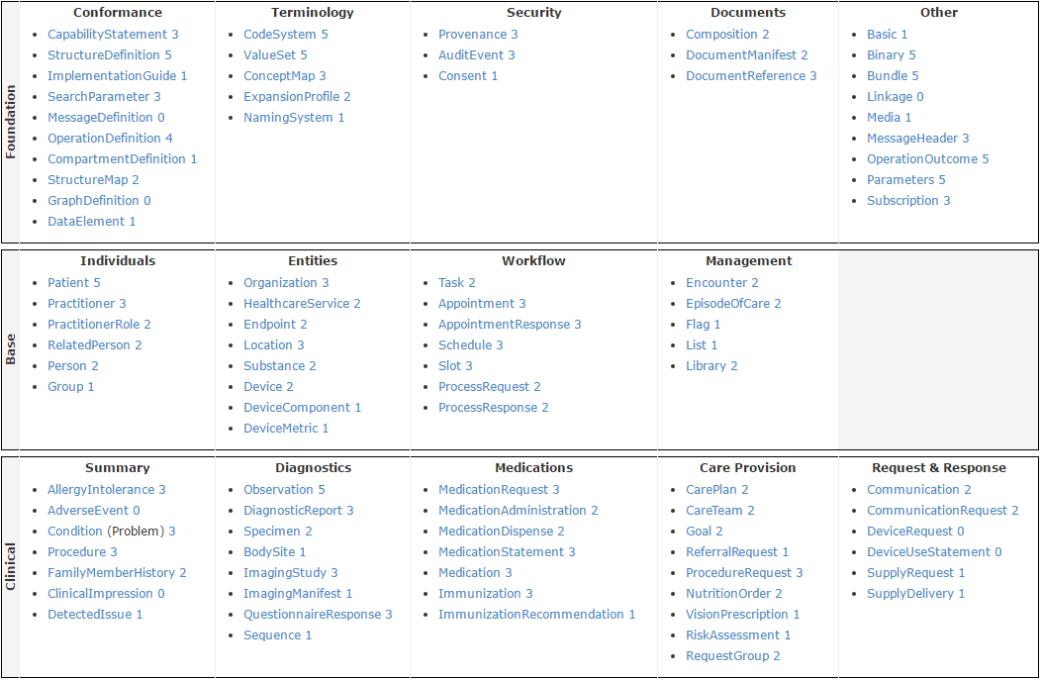
STU 3 Resource List

Slide 44
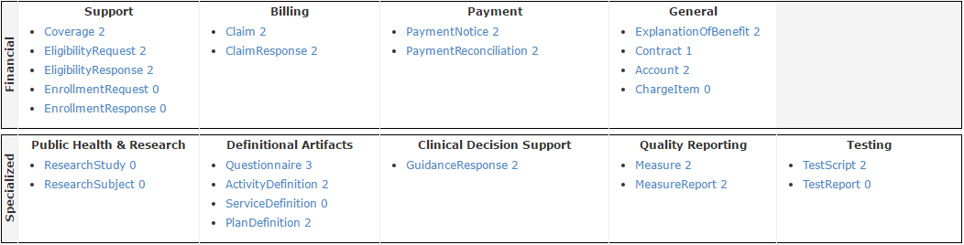
STU 3 Resource List

Slide 45
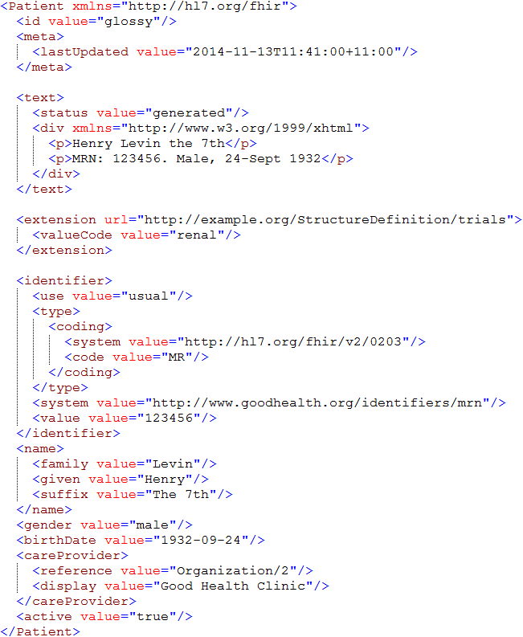
Identity & Metadata
Human Readable Summary
Extension with reference to its definition
Standard Data Content:
MRN
Name
Gender
Date of Birth
Provider

Slide 46
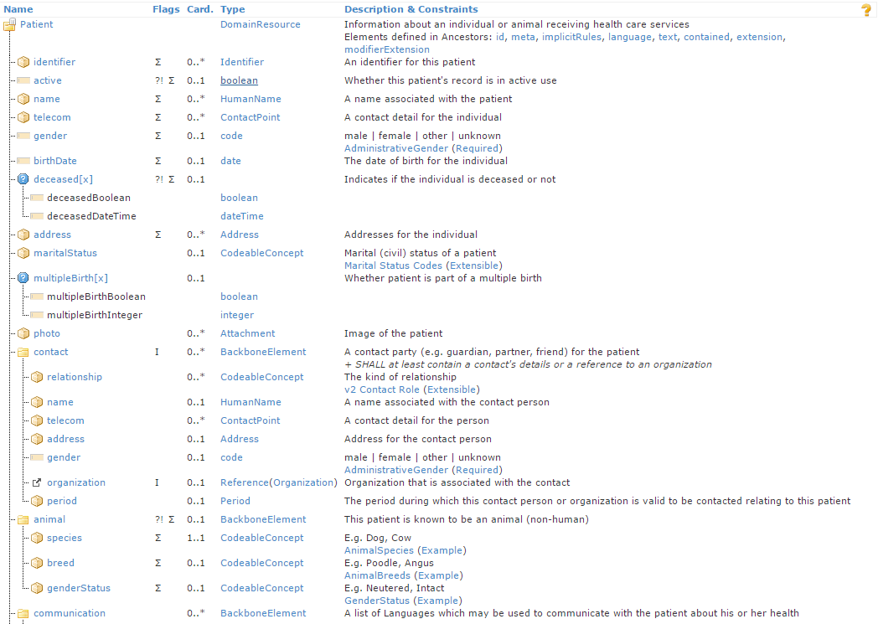
Resource Definitions

Slide 47
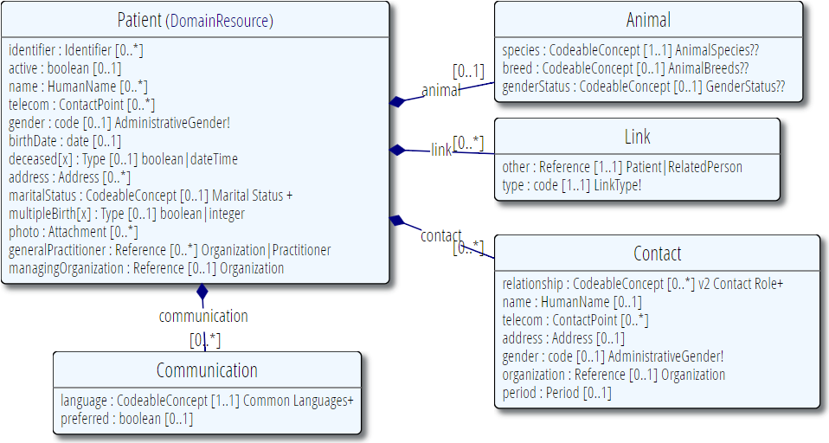
Resource Definitions

Slide 48
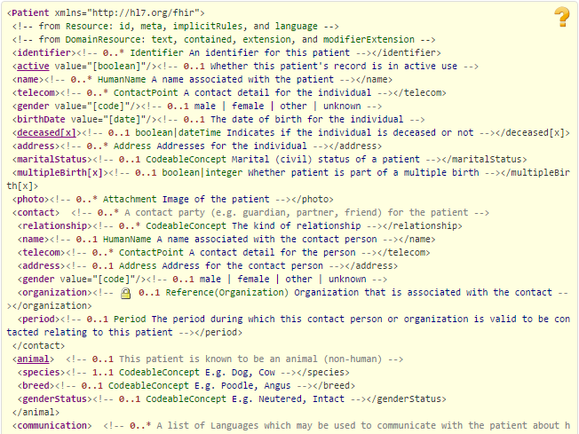
Resource Definitions

Slide 49
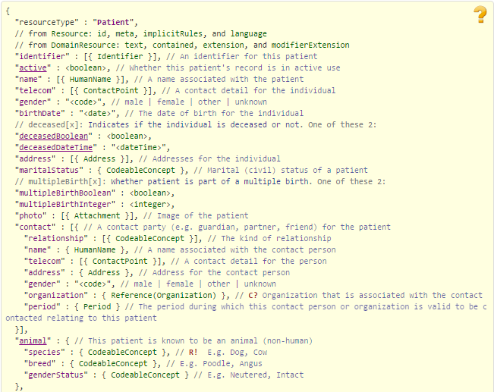
Resource Definitions

Slide 50
Why resources?
Increases re-use
Can use the same resource structures (and profiles on them) in many solutions
Lighter-weight communication
Can point to resources “by reference” rather than sending all data
Aligns well with how data is stored

Slide 51
What’s in a resource definition?
Each resource defines:
What elements are part of “core”
Names
Definitions
Cardinality
Code lists
Mappings (to RIM, v2 and other specs)
Constraints
All in a computable form
Create spec, schemas, reference implementations

Slide 52
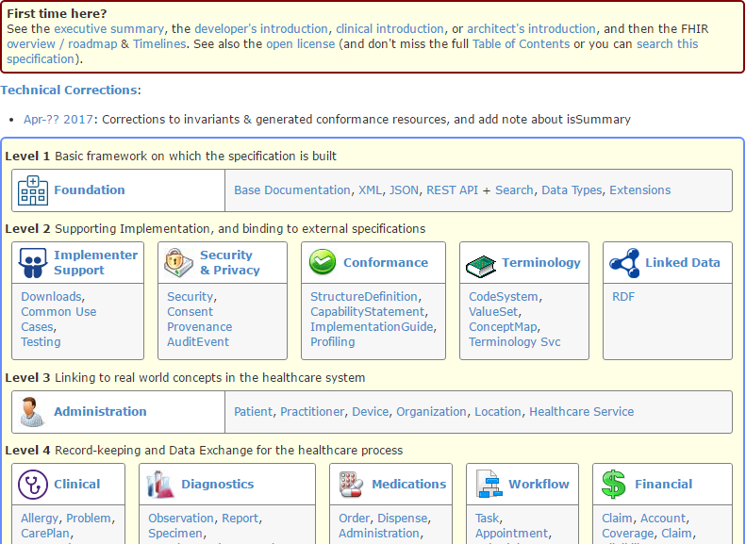
(FHIR home)
hl7.org/fhir
Notes:
Published as HTML
Published using validation process that performs consistency checks – like a software build
Really shouldn’t require much guidance to read, but a few things to call out
Objective of spec is developer can skim and decide in < day

Slide 53
Break!
Notes:
Toggle

Slide 54
Outline
Before break
After break
Why FHIR?
What makes FHIR different?
Core principles
Power of an interface
FHIR Resources
How does FHIR Compare?
FHIR Status
Where is FHIR being used?
Risks & Next steps
Notes:
Toggle

Slide 55
Outline
Monday
Tuesday
Why FHIR?
What makes FHIR different?
Core principles
Power of an interface
FHIR Resources
How does FHIR Compare?
FHIR Status
Where is FHIR being used?
Risks & Next steps
Notes:
Toggle

Slide 56

Questions?
http://hl7.org/fhir lmckenzie@gevityinc.com

Slide 57
FHIR for Executives 2 of 2
Lloyd McKenzie
April 25, 2017

Slide 58
Outline
Monday
Tuesday
Why FHIR?
What makes FHIR different?
Core principles
Power of an interface
FHIR Resources
How does FHIR Compare?
FHIR Status
Where is FHIR being used?
Risks & Next steps
Notes:
Toggle

Slide 59
How does FHIR compare?

Slide 60
V2 and FHIR
Similarities
FHIR Differences
Built around re-usable “chunks” of data
Strong forward/backward compatibility rules
Extensibility mechanism
Each chunk (resource) is independently addressable
More than messages
Human readable required
Extensions don’t collide, are discoverable
Modern tools/skills
Instances easy to read
Lighter spec
Notes:
Many interface engine vendors working on FHIR support
May make sense for internals of some v2 systems
Add-on interface for mobile, personal health record

Slide 61
V3 and FHIR
Similarities
FHIR Differences
Based on RIM, vocab & ISO Data types foundations
Support XML syntax
Simpler models & syntax (reference model hidden)
Friendly names
Extensibility with discovery
Easy inter-version wire compatibility
Messages, documents, etc. use same syntax
JSON syntax too
Notes:
Lower learning curve
Unlikely to see significant new v3 initiatives in areas that aren’t already committed to it

Slide 62
FHIR and CDA
Similarities
FHIR Differences
Support profiling for specific use-cases
Human readability is minimum for interoperability
APIs, validation tooling, profile tooling
(See v3 similarities on prior slide)
Initial discrete interoperability with the base specification (no templates)
Not restricted to just documents
Implementer tooling generated with spec
(See v3 differences on prior slide)
Notes:
Significant work on CCDA <-> FHIR
Can use both FHIR and CCDA documents with XDS and with MHD

Slide 63
FHIR and Services
Similarities
FHIR differences
Encourage context neutral, re-usable structures with defined behavior
RESTful interface is a simple SOA interface
Consistent data structures across services
Ease of transport across paradigms message <-> service <-> document <-> REST
Standard framework for defining/discovering services
Notes:
FHIR allows defining simple services via the “OperationDefinition” mechanism as well as custom services.
E.g. Value set expansion, code translations – full terminology services

Slide 64
So why use anything else?
FHIR is brand new
Minimal market share
Not yet normative
Limited track record
Business case
No-one dumps existing working systems just because something new is “better”
Most Large projects committed to one standard won’t change direction quickly (or even at all)

Slide 65
FHIR as a replacement
Yes, FHIR has the potential to supplant HL7 v3, CDA and even v2
However
It’s probably not going to do so right away
HL7 will support existing product lines so long as the market needs them
Notes:
Few will throw away their investment in older standards to use FHIR until
The specification has a good track record
It’s clear the new thing provides significant benefits

Slide 66
Status of FHIR

Slide 67
FHIR Timeline (planned)
First Draft
1st
STU
~ 2nd
STU
~ 3rd
STU
R4
. . .
2011
2012
2013
2014
2015
2016
2017
2018
2019
2020
Notes:
Note that dates are subject to change based on resources and the standards process

Slide 68
STU 3
Published March 2017
New resources for research, infrastructure
Improved quality (higher maturity), response to implementers, workflow alignment
Migration of multiple resources from draft to STU

Slide 69
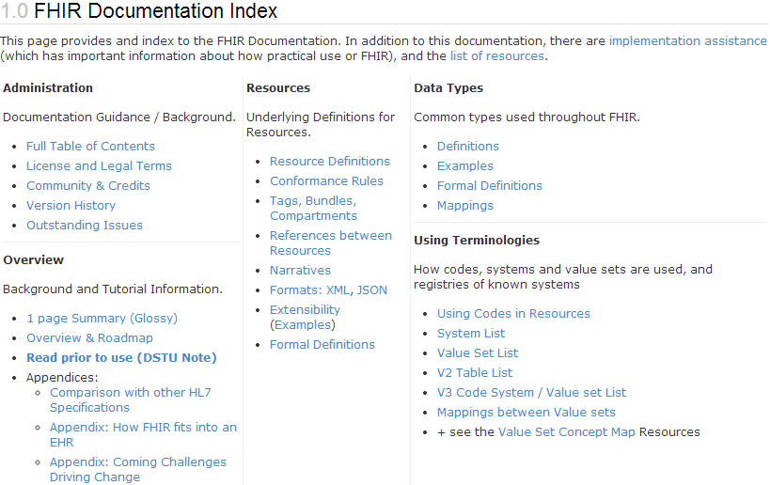
What does STU mean?
“…all aspects of the FHIR specification are potentially subject to change
Notes:
Split resources, dropped resources, changed JSON and XML syntax, added and changed elements, renamed data types

Slide 70
Maturity levels
Intended to indicate level of stability
FMM1 – Resource is “done”, no build warnings
FMM2 – Tested at approved Connectathon
FMM3 – Passes QA, has passed ballot
FMM4* – Tested across scope, published, prototype implementation
FMM5* – 5 distinct production implementations, multiple countries, 2
Non-compatible changes at level 4 and 5 will face increased hurdles

Slide 71
Normative FHIR
Will include
Core specification
Structural resources
Subset of other resources
Some resources won’t go normative right away
Future releases
Add more resources
Add profiles on existing resources
May add elements to resources
Very rare

Slide 72
Using FHIR

Slide 73
Where can FHIR be used?
Classic in-institution interoperability
Back-end e-business systems (e.g. financial)
Regional Health Information Organizations (RHIO)
National EHR systems
Social Web (Health)
Mobile Applications
Near
Term

Slide 74
Implementation during STU
FHIR is new
No commitment yet to backward compatibility
No stability guarantee until 2018+
Some resources didn’t exist in initial version
Appointment, Referral, Insurance, Nutrition, etc.
However, implementers chose to build with it anyhow and have continued to do so

Slide 75
Who’s working with FHIR?
> 1000 organizations
attended a Connectathon and/or
implementation work in progress
Hard to track who’s doing what
Over 500 active participants on the FHIR Implementer’s chat
http://chat.fhir.org
25+ countries involved so far

Slide 76
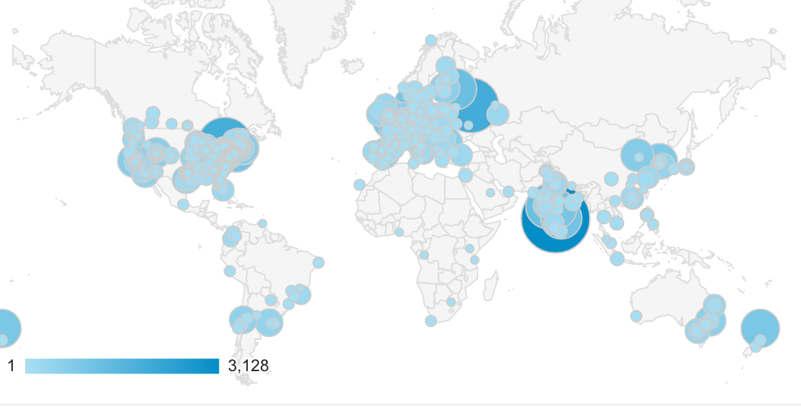
Who’s using FHIR?
Systems accessing HAPI server in previous year (as of 2017-05)
Notes:
Jan->mid Nov. 2015 – unique systems accessing the HAPI test server

Slide 77

FHIR & other SDOs
IHE
Using FHIR for MHD (mobile XDS)
FHIR profile for PIX/PDQ, CMAP, RECON, Accountable Order, ATNA, others
DICOM
Building profile to make key images available to EHR
W3C
Semantic health group helping us with RDF, RIM-based semantic checking
Notes:
Because FHIR is free and because of how it’s structured, use by other SDOs is certainly possible CMAP = Clinical Mapping; RECON = reconciliation, Assessment of orders for accountable use criteria in guidelines

Slide 78
Governments
US – ONC
Sponsored 4 projects, including mapping meaningful use to FHIR
UK
One implementation live, lots more in the pipeline
Lithuania
Chose FHIR as the basis for their national EHR

Slide 79
EHR Vendors
Many significant EHR vendors have made commitments to FHIR implementation
AllScripts, Cerner, Epic, McKesson, Meditech
Voluntarily investing in accelerating the standard
E.g. Argonaut, participating in standards development

Slide 80
Other support
Large and small healthcare organizations
E.g. Mayo, Intermountain Healthcare, University Health Network
Small vendors, start-ups
Lots and lots – all over the world

Slide 81
FHIR & CDA
HL7 developing FHIR profiles for CCDA
Will have key ones present in next STU
HL7 project to define “Clinical Document Architecture” in FHIR
At least 3 projects looking at providing automated transformation between CCDA and FHIR

Slide 82
HSPC
Health Services Platform Consortium
Intermountain Healthcare, Veterans Affairs, Harris, Telus, Dignity Health, IBM, Epic, Cerner, Mayo, HP, Kaiser, +++ (not all are official members)
Leverage FHIR + security and additional layers to allow plug & play EHR modules
Stems from SMART on FHIR work

Slide 83
Business Cases for FHIR

Slide 84

Mobile Friendly
RESTful interface & JSON support are “natural” for web-based solutions
APIs – including Swift make mobile solution easy
Resources are lightweight = faster response times
Documentation appeals to mobile developers, less learning curve

Slide 85
Context-free interfaces
RESTful interface is generic
No need to define message events or payloads
Query what you need
One interface can work for multiple partners & solve multiple communication needs
Extensions allow support for specialized needs
Business rules move from the interface to the access control layer
Faster/more dynamic configuration

Slide 86
Bulk data
Most healthcare interfaces are narrow in scope
Specific patient, specific encounter, specific event
FHIR supports querying whatever’s of interest
All of a patient’s record I’m allowed to see
All data for my patients
All data related to condition X across patients
Subscriptions allow data to be pushed

Slide 87
Profiling and Validation
Conformance artifacts in FHIR are defined computably and resolvable computably
Allows robust validation, including terminology
Support for automated testing of interfaces
Allows sharing of profiles, clinical practice guidelines
Allows dynamic configuration of application behavior and user interface

Slide 88



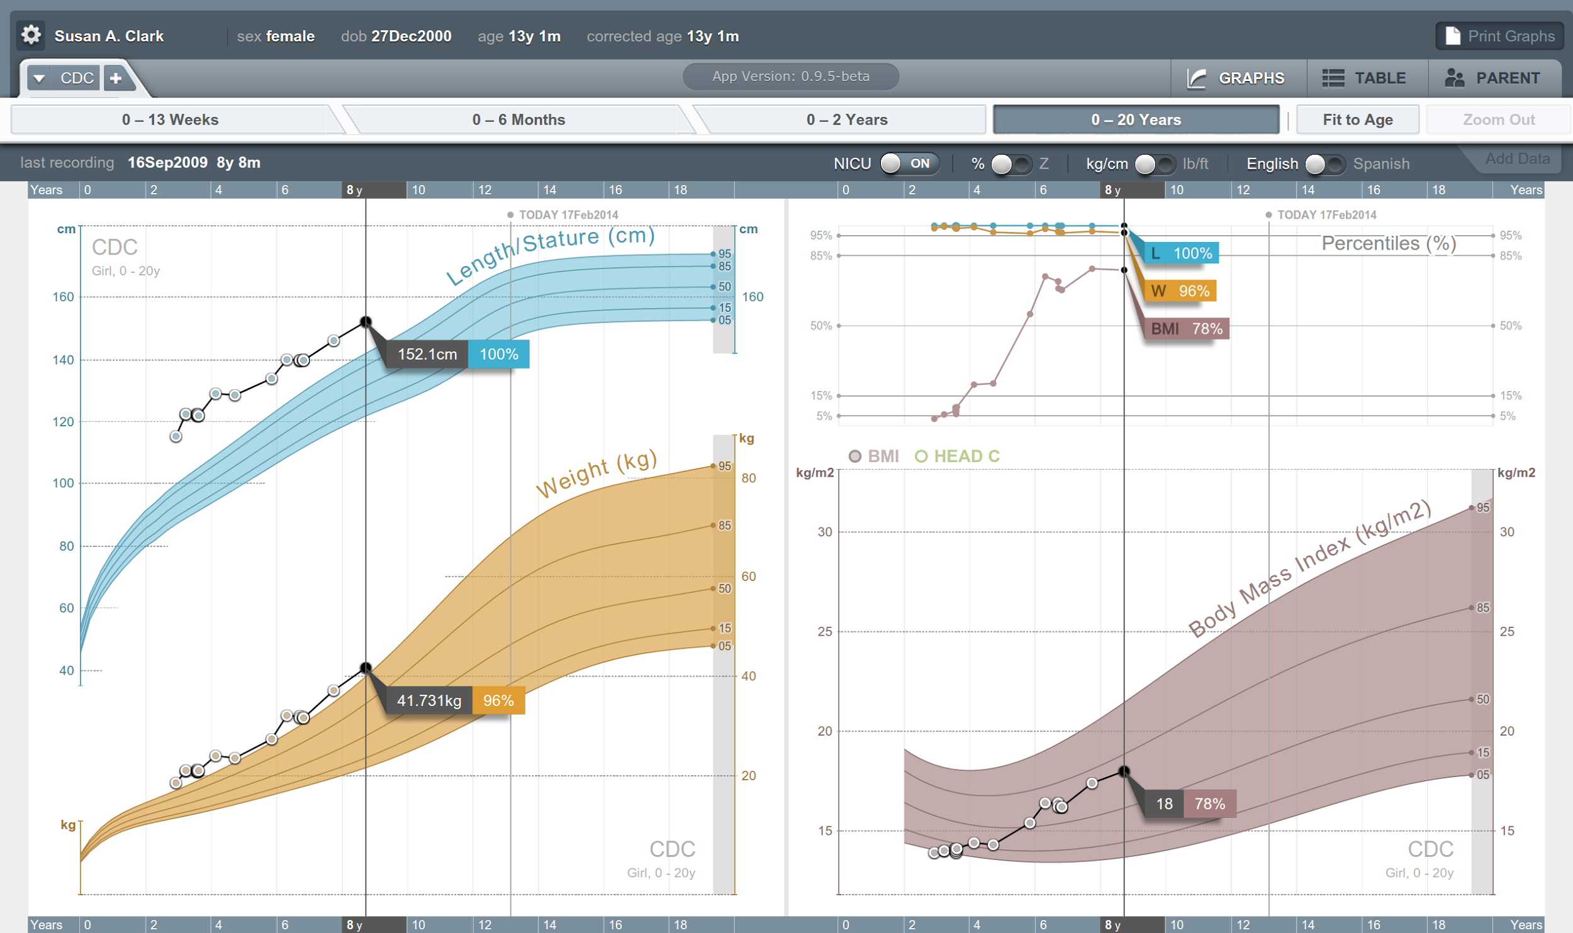


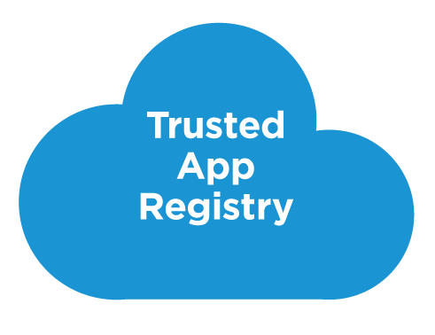



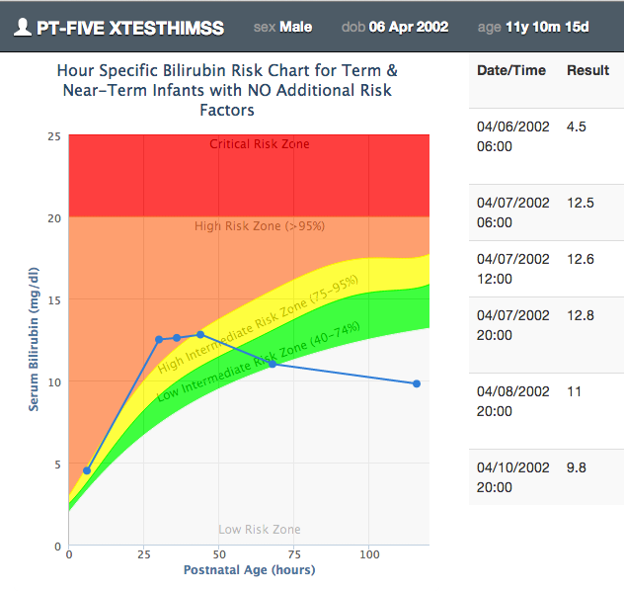







SMART on FHIR
Mobile Apps
Web Apps
OAuth2
REST API
MU-oriented FHIR Data Profiles
Underlying Health IT Systems
Your system here.

Slide 89
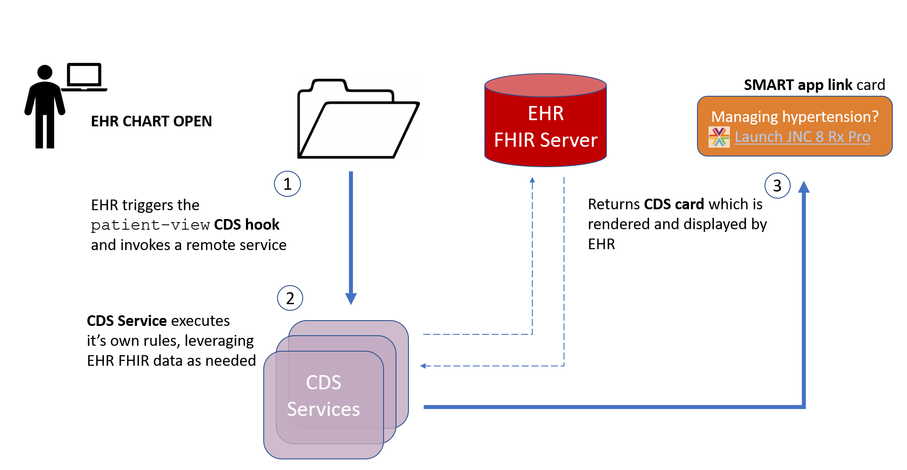
CDS Hooks

Slide 90
Documents that are easier
FHIR allows documents that are easier to use than CDA
Data can easily be consumed and used for other purposes
RESTful interface
Decision support
Etc.
Use documents for what they’re meant for, rather than everything

Slide 91
Leverage the Community
FHIR has attracted far greater attention and energy than any previous HL7 specification
Almost 8000 change requests
Up to 2500 chat.fhir.org messages/week
~180 FHIR-related sessions at San Diego WGM
Spawned university courses, open source projects, conferences, etc.
That energy attracts implementers and provides better support

Slide 92
Additional insights
Furore Executive Videos series
http://fhir.furore.com/Education#videos
FHIR Applications Roundtable (Jul 2016)
https://www.pathlms.com/hl7/courses/3152

Slide 93
FHIR Risks
And mitigations

Slide 94
Risks with FHIR
FHIR is new
Be ready to migrate
Caution for mission critical applications
FHIR is cool
Be realistic about what’s achievable
Work with others (HL7, IHE, etc.) to build profiles
FHIR is coming
At minimum, monitor
Consider whether to pilot to build experience
Notes:
Still in STU
No backward compatibility guarantee
Some content missing
Limited production experience
Change is likely
Near the top of the hype curve
FHIR won’t fix all interoperability issues
Consensus, terminology, legacy burdens still exist
FHIR provides a framework and platform
Hard work still in profiling
Mitigations
Be realistic about what’s achievable
Work with others (HL7, IHE, industry groups) on the profiles you’ll need
Momentum is high – it will disrupt the health IT environment
Strong interest from regulators (e.g. ONC)
Strong interest from major vendors
Hitting at all points in the market chain
Plan what you could do, decide conditions for entry

Slide 95
Next Steps
For you and your organization

Slide 96

Next Steps
Is this something your organization wants/needs to track?
Monitor
Have someone sign up to the FHIR list or Zulip chats
(instructions on the wiki)
http://wiki.hl7.org?title=FHIR
Engage
Have someone read through the specs
Send someone to development tutorials
Have your organization participate in or observe a connectathon
Participate in the upcoming STU ballot

Slide 97
Education opportunities
Attend a Working Group Meeting
Tutorials, Connectathons
Jan 26-Feb 2 New Orleans
May 11-18 Cologne
Sept 28-Oct 5 Baltimore
FHIR Institute Webinars
Dec 1-5
2018 Schedule TBD
Custom education available

Slide 98






International HL7 FHIR Developer Days November 15-17, 2017 in Amsterdam
(And for the first time in the U.S.: June 19-21, 2018)
Education
34 speakers
70+ tutorials/presentations
5 tracks
Connectathon
Meet fellow developers
Put FHIR to the test
Networking
FHIR experts and authors on hand
http://fhir.furore.com/devdays

Slide 99
Final message
FHIR
is easier and cheaper
is being implemented now
is likely to significantly impact Health IT
Decide how you want it to impact your organization

Slide 100
Questions?
http://hl7.org/fhir lmckenzie@gevityinc.com

